Slide 1

Fairness among TCP connections
Alaa Abo Mokh
Adan Jbara
Adan Wattad

Slide 2


Project Goals
The objective of this project is to evaluate and compare the fairness of different congestion control protocols. The evaluation is performed using a Dumbbell topology to simulate network conditions. Fairness is assessed according to three key criteria:
Jain’s Index
Max-Min Fairness

Slide 3

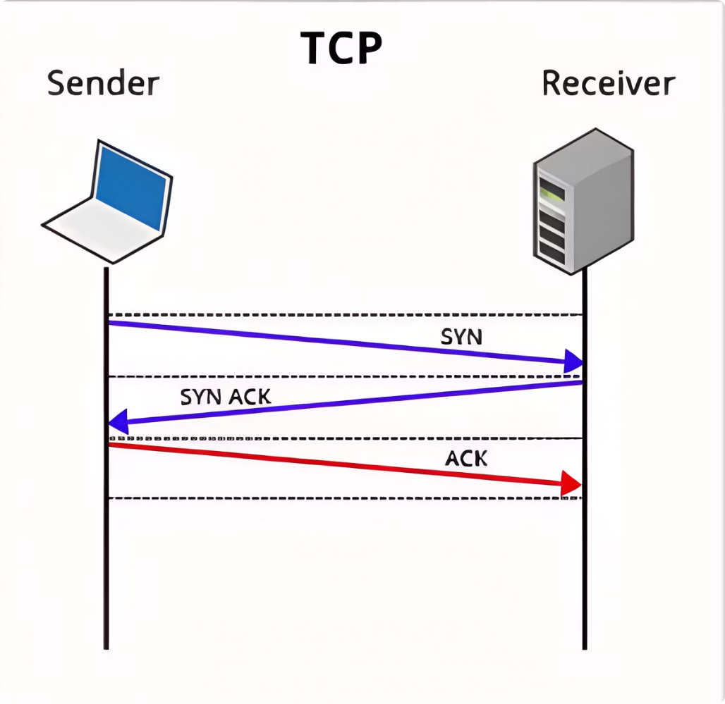
TCP
Connection Oriented
Congestion Control
Reliable
Flow Control
Error Handling

Slide 4
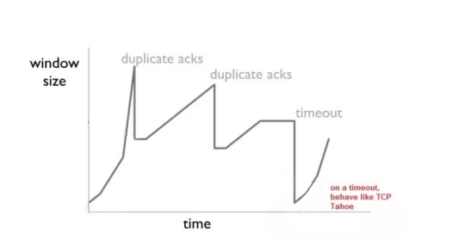
TCP New Reno
Fast Recovery & Fast Retransmition
Retransmit lost packets on triple duplicate ACKs
AIMD
Adjusts sending rate dynamically
Supports Partial ACKs
Retransmit only missing packets
Better throughput and latency
Allows for continued transmission during fast recovery

Slide 5
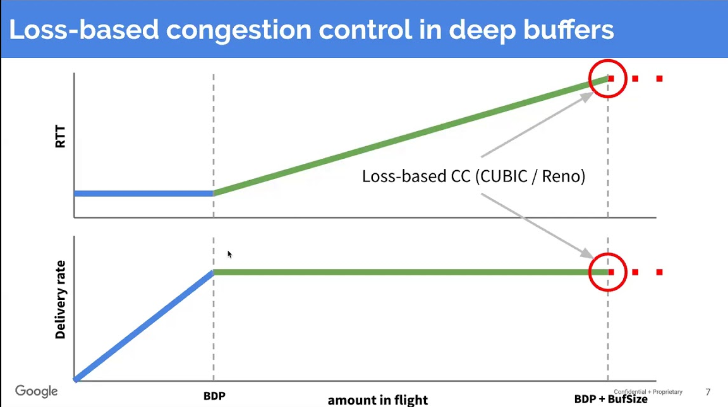
BBR
How BBR Works:
Key Features of BBR:
Estimates Bottleneck Bandwidth
Optimized for high-bandwidth, high-latency
Measures RTT
Reduces packet loss
Adjusts Congestion Window
Minimizes latency & Improves fairness
Cwnd = BtlBw x Rtprop

Slide 6
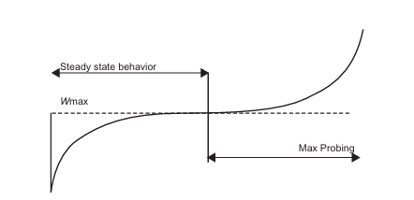


CUBIC
high-bandwidth, high-latency networks
Cubic window growth (not linear)
Detects congestion through packet loss
RTT-independent performance
In theory CUBIC is RTT-independent

Slide 7
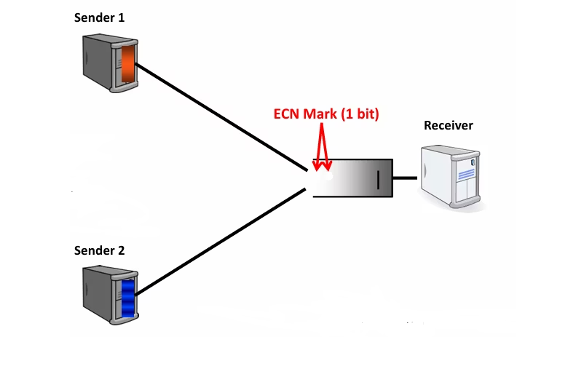
DCTCP
Optimized for high-speed, low-latency data centers
Uses ECN for early congestion detection
Maintains minimal packet loss
Achieves high throughput
Ensures low latency communication

Slide 8
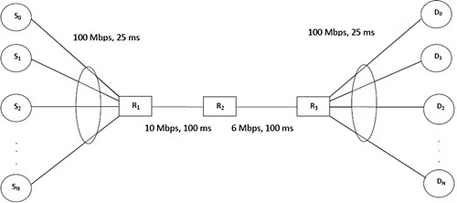
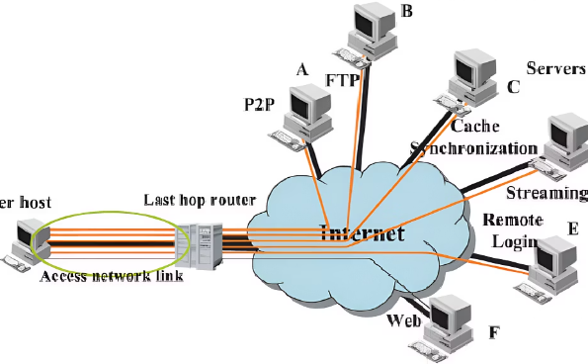
Dumbbell Topology-
Bottleneck
•High-capacity center link
•Bottlenecks occur in high-traffic zones
•Simulates bottlenecks
•Often found at the center link

Slide 9



Fairness Computation
Max-Min Fairness
Jain’s Index
measures the equality of resource distribution among users
One can not increase the rate of a flow, without decreasing the rate of another flow having equal or lesser rate

Slide 10

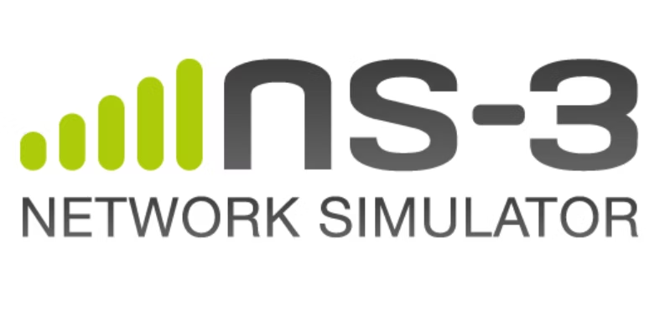
ns3
Purpose
Benefit
a discrete-event network simulator, used for research and educational purposes.
provides a realistic simulation environment for internet protocols
Key Feature
NS-3 supports modular design

Slide 11

Experiment Variations
1
Vary the RTT uniformly across simulations, keeping all flows within each simulation run assigned the same RTT value.
2
In each simulation, one flow has fixed RTT of 100 ms, while the other flow’s RTT is scaled
by a factor k to create RTT asymmetry.

Slide 12

Protocol Environment Types (What Protocols Are Used in Each Setup)
Environment Type 1 – Single Protocol
Environment Type 2 – Two Protocols (Split Senders)
All senders use the same TCP variant, varied across runs: NewReno BBR, CUBIC, DCTCP
The sender population is split evenly between two protocols: NewReno & CUBIC, BBR & CUBIC, NewReno & BBR
All simulations were conducted using two concurrent TCP flows to evaluate performance and fairness.

Slide 13
The project's stages
1. Learning stage
2. Building the topology using NS-3
3. Setting the bandwidth and other constants (e.g., delay) in the simulation
4. Defining the variables and their values
Studied the theoretical background and Learned how to use NS-3
Dumbbell topology with 2–4 flows
e.g. rtt=0,20,40,60,100 (Ms)

Slide 14
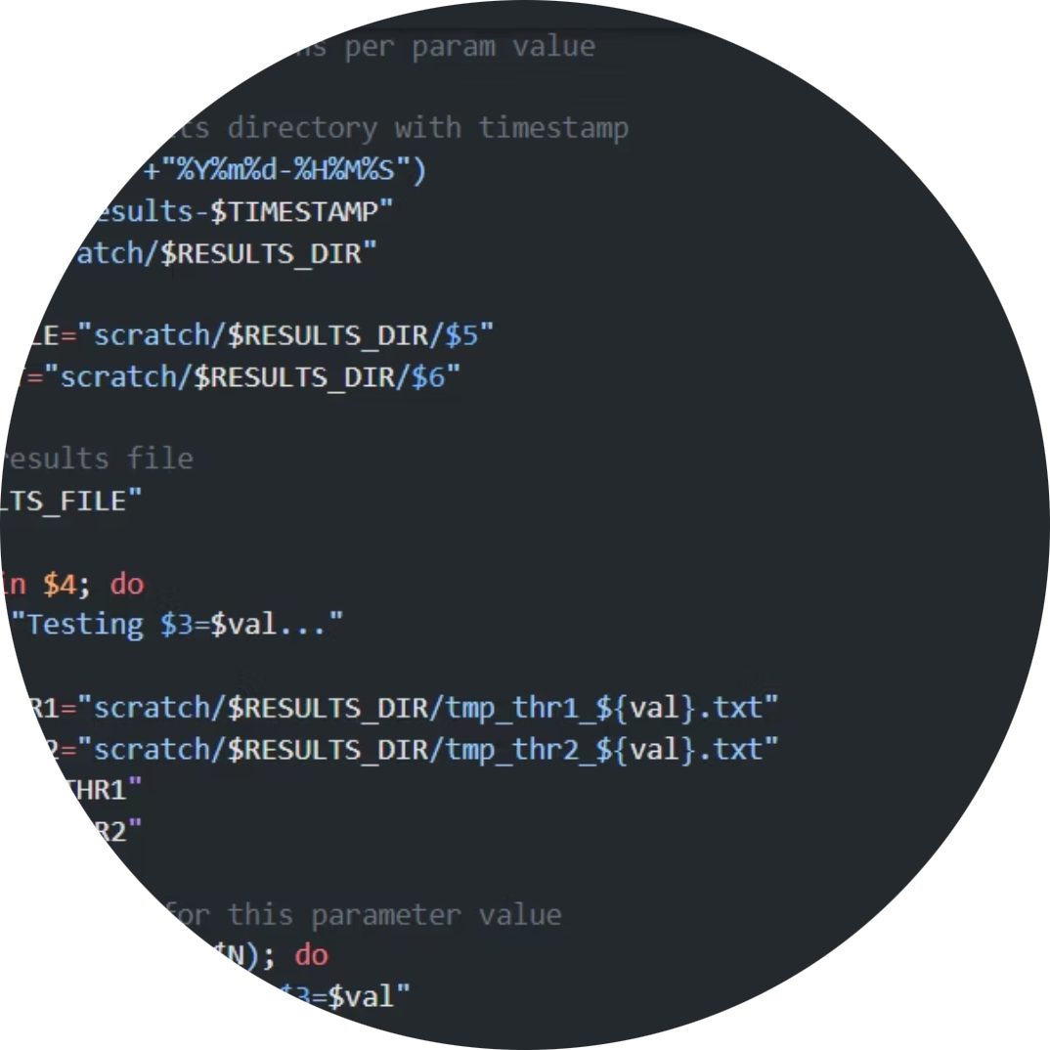
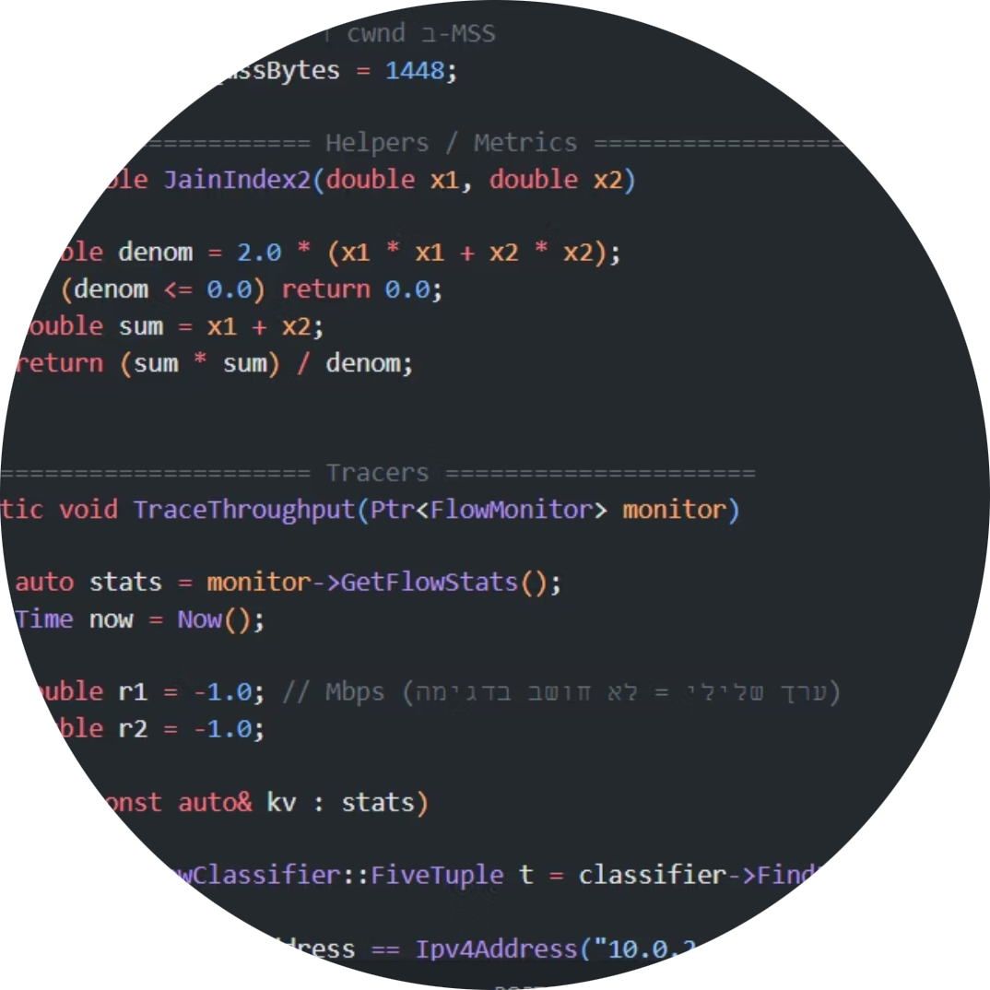

5. Creating the script
6. Running the simulations
7. Analyzing the results and drawing conclusions

Slide 15
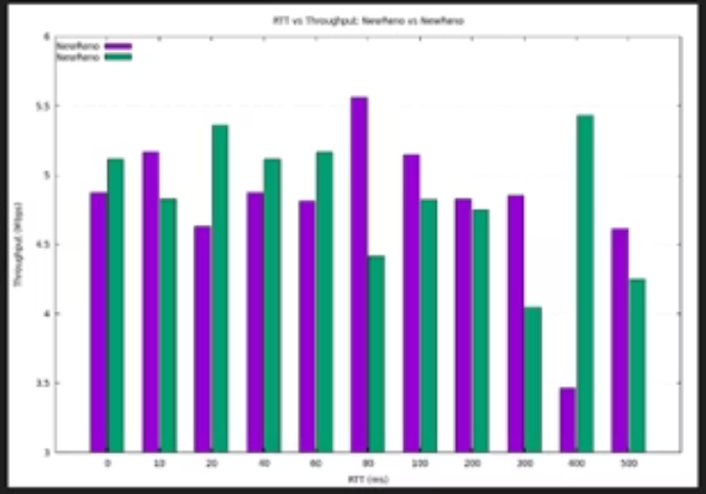
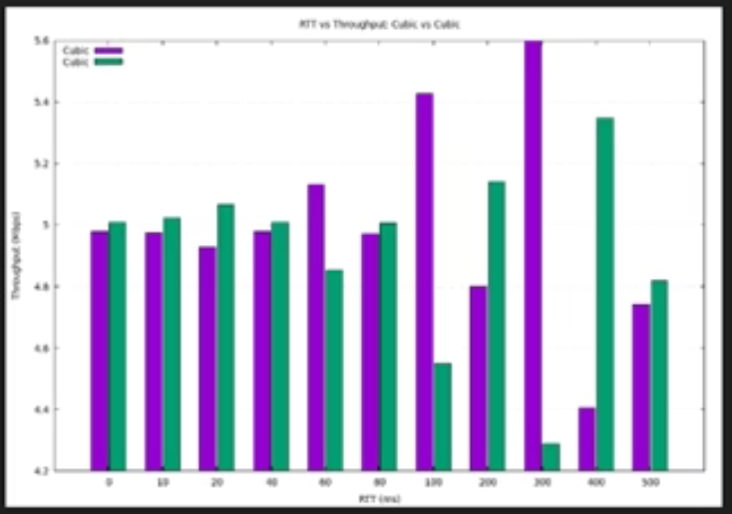
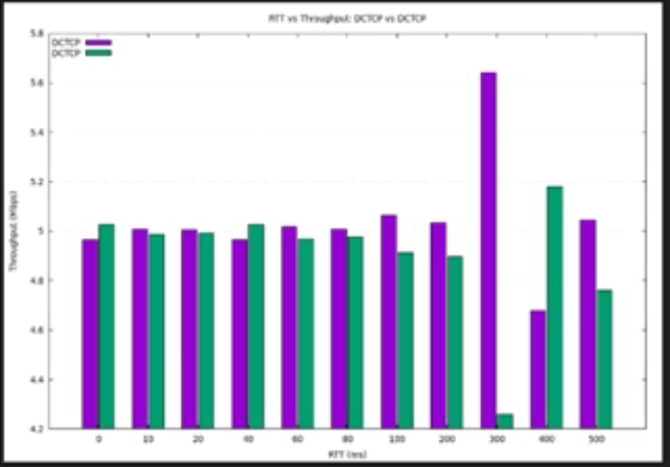
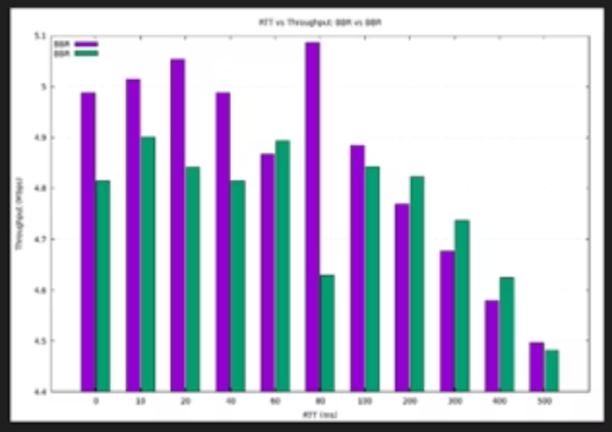
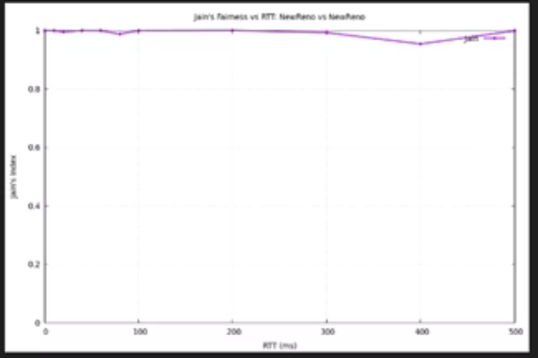
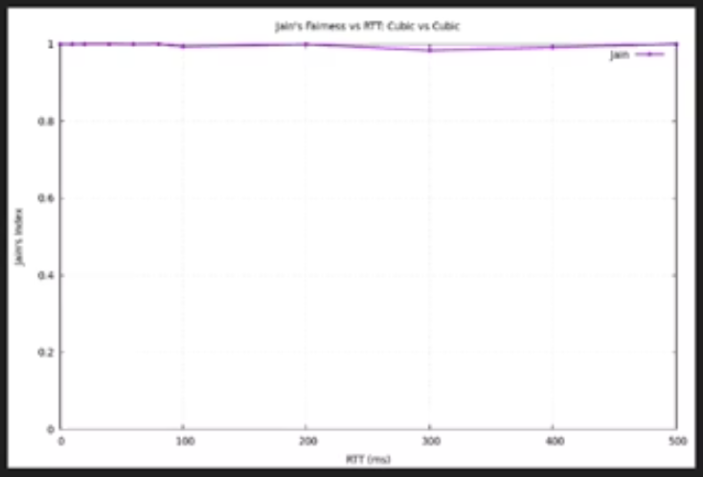
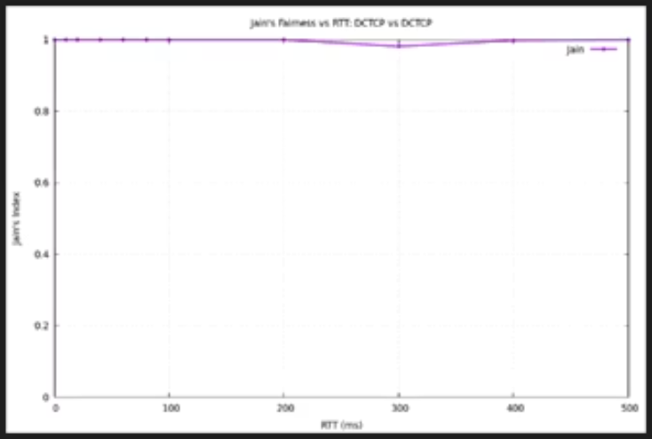
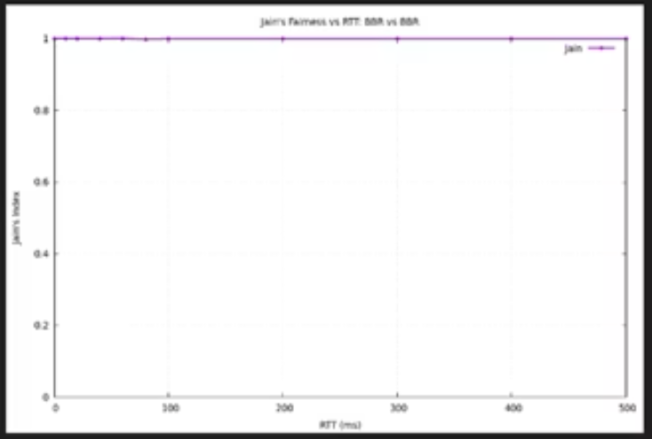
Results- same RTT
Same Protocol
NewReno-NewReno
Cubic-Cubic
Dctcp-Dctcp
BBR-BBR

Slide 16
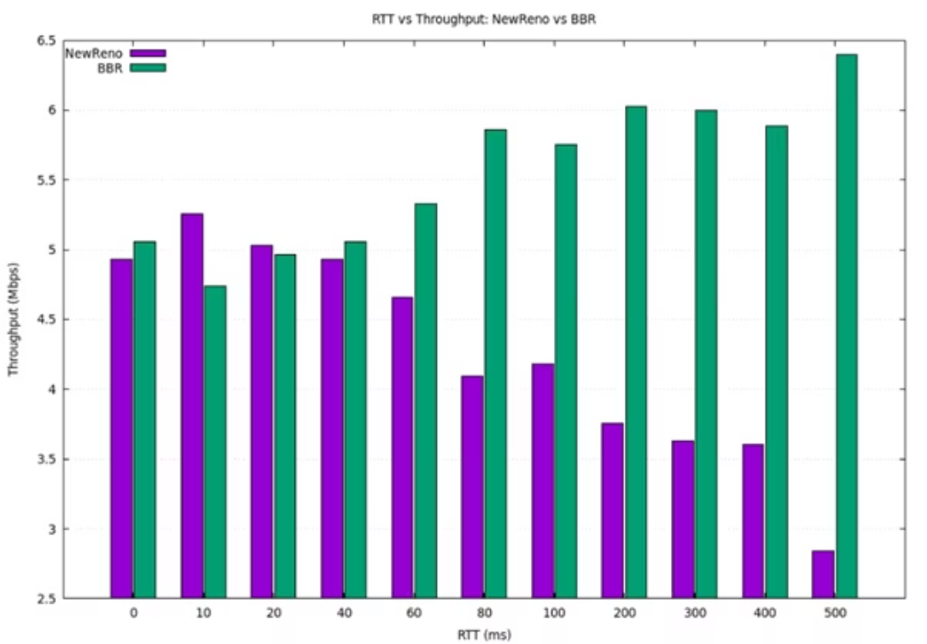
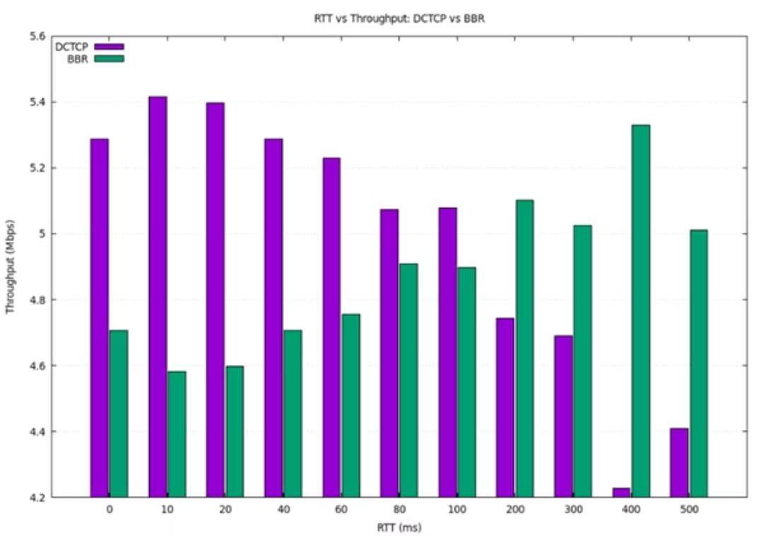
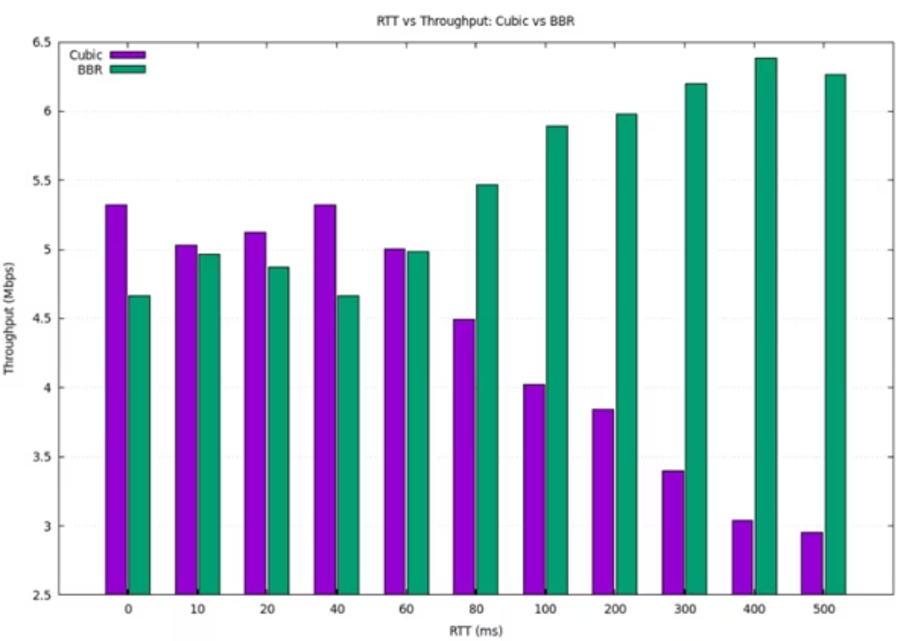
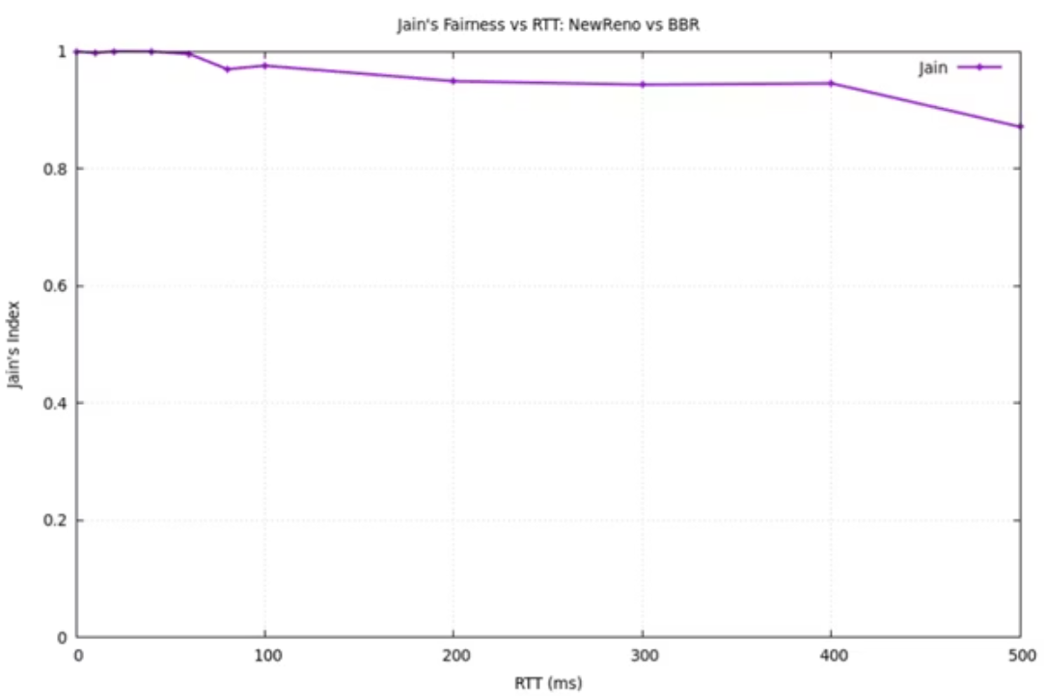
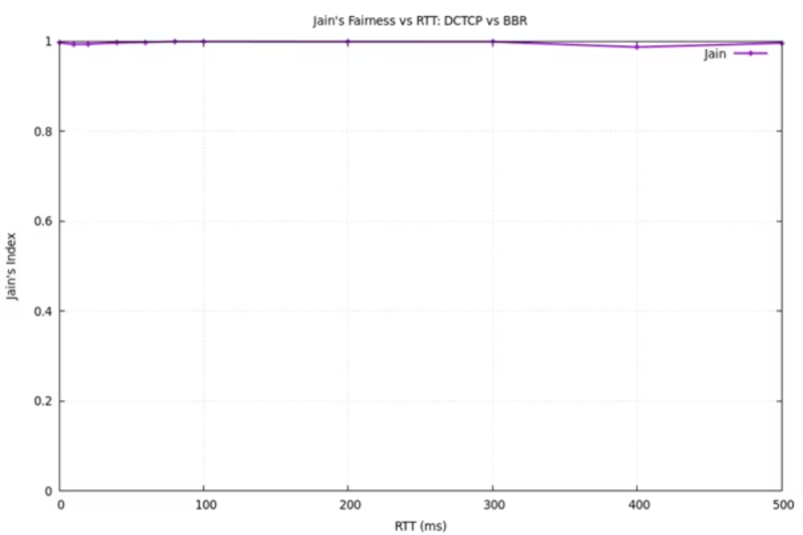
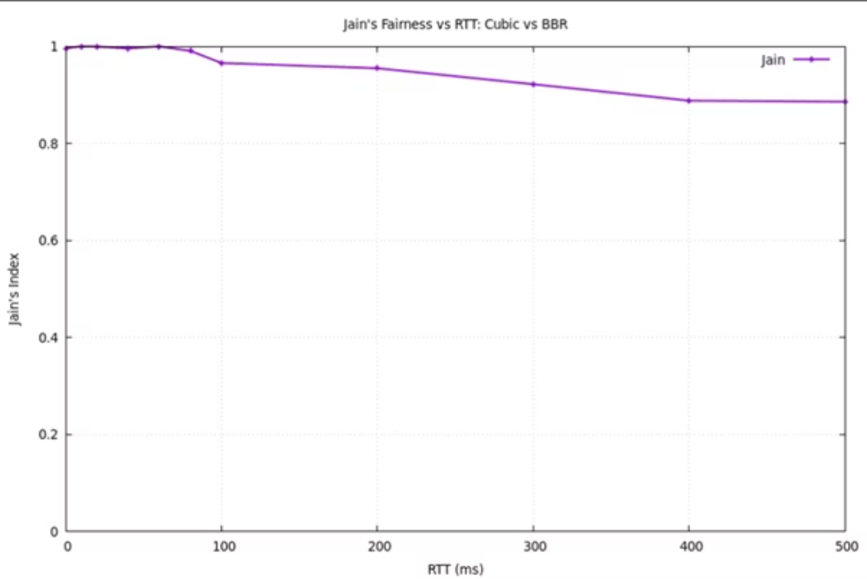
Results- same RTT
different protocols
BBR-NewReno
BBR-Dctcp
BBR-Cubic

Slide 17
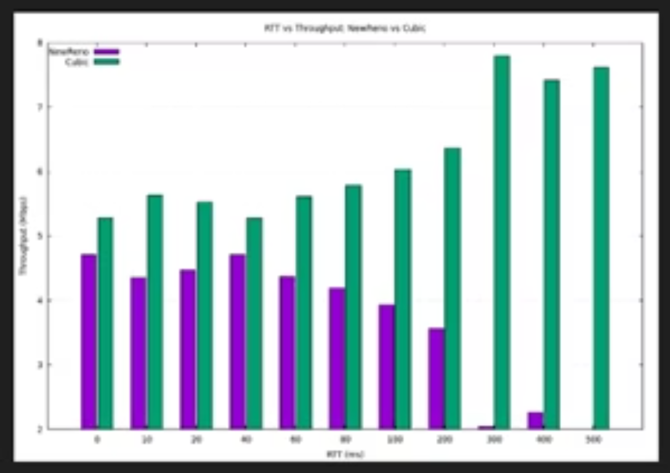
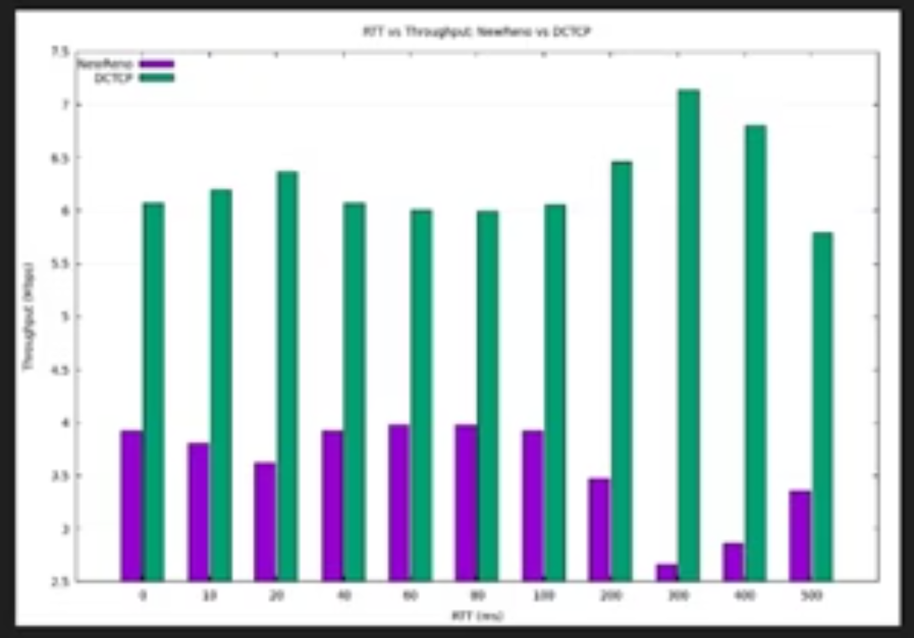
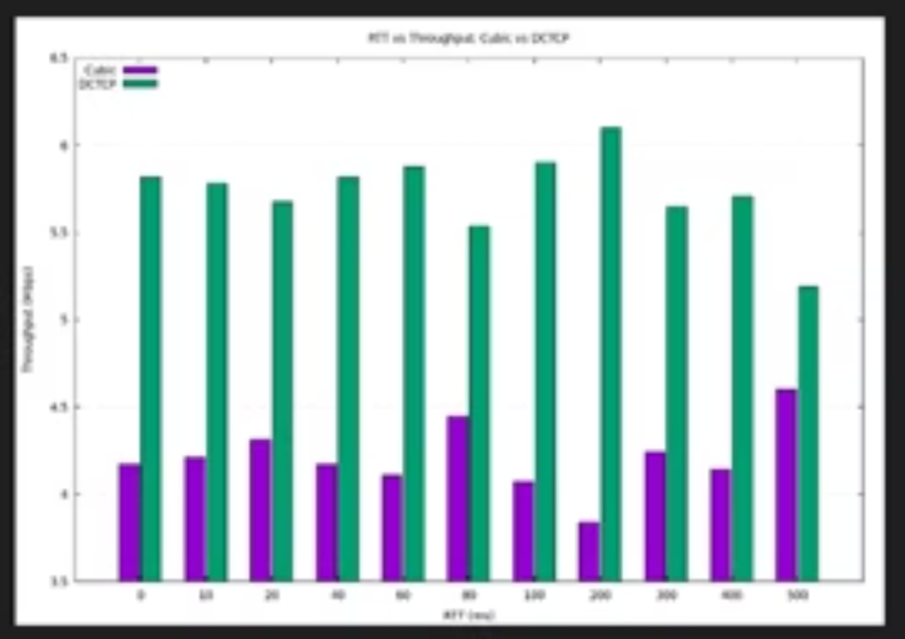
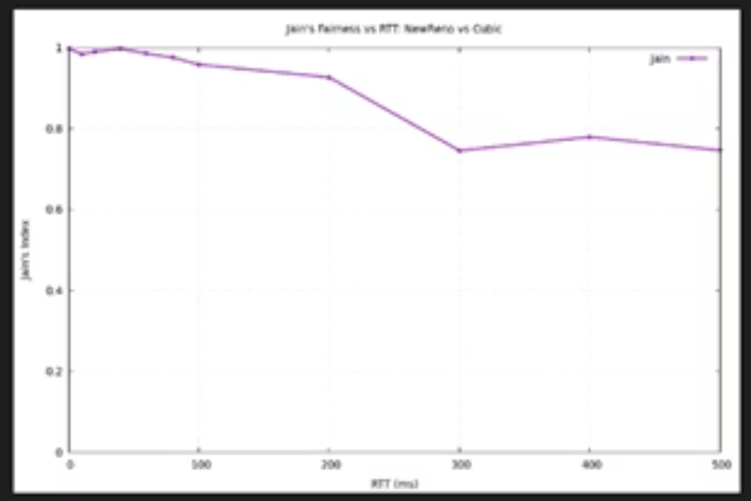
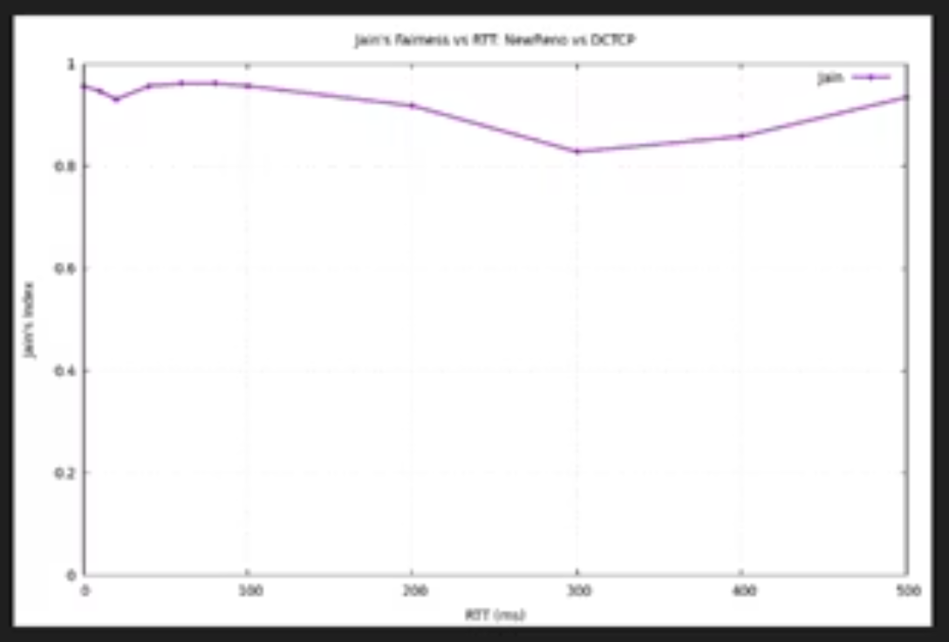
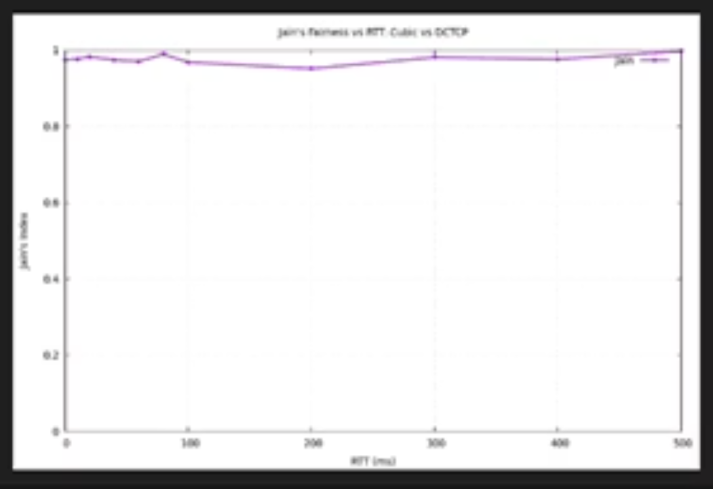
Results- same RTT
different protocols
NewReno-Cubic
NewReno-Dctcp
Dctcp-Cubic

Slide 18
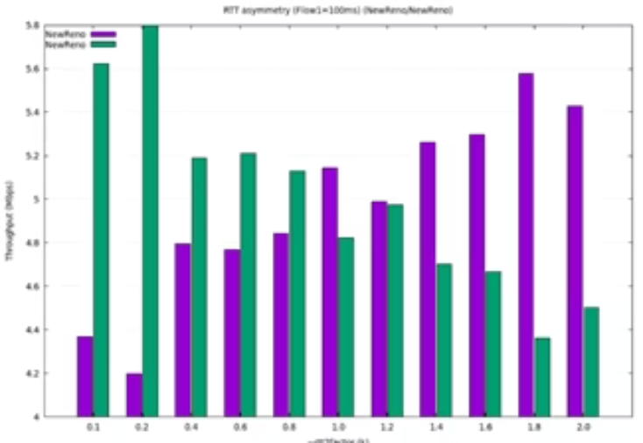
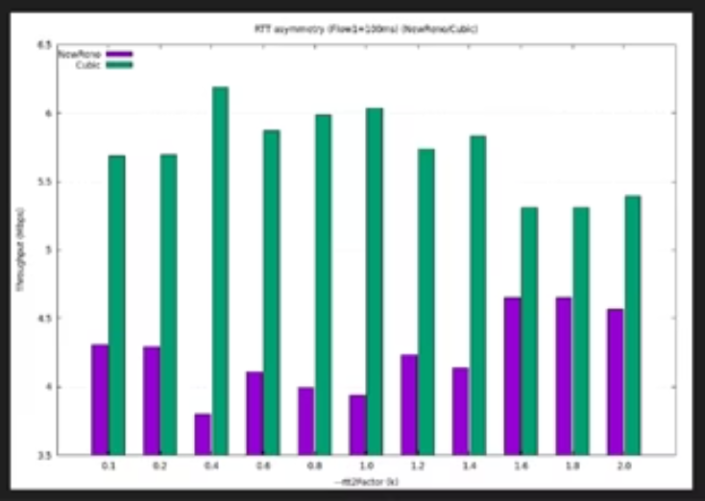
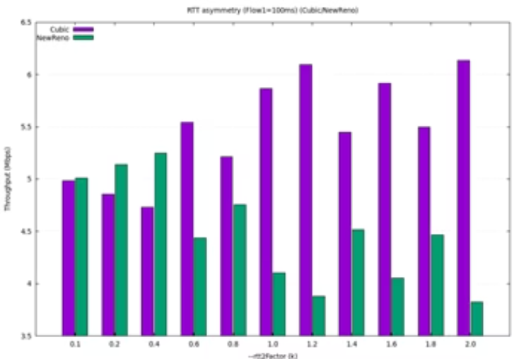
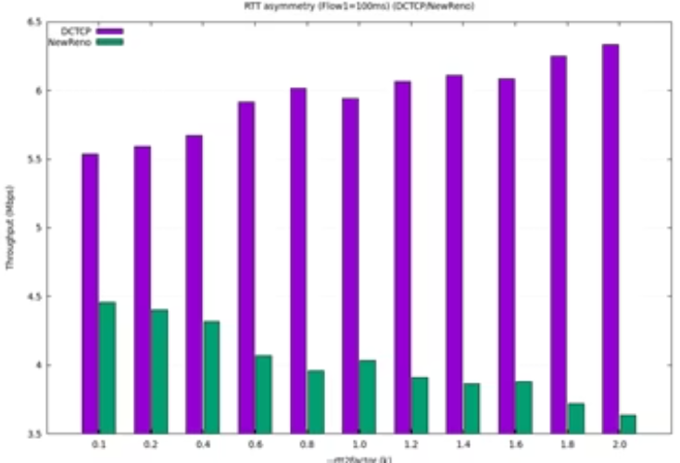
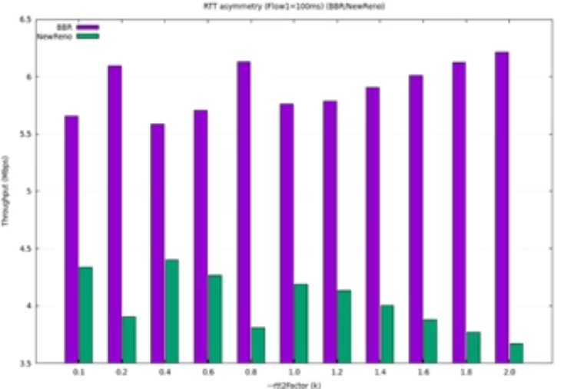
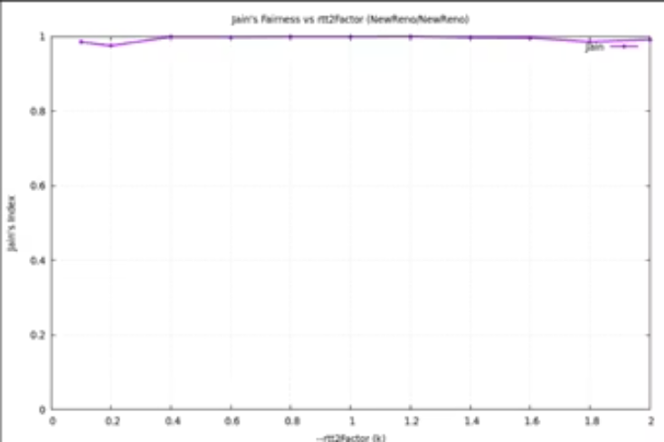
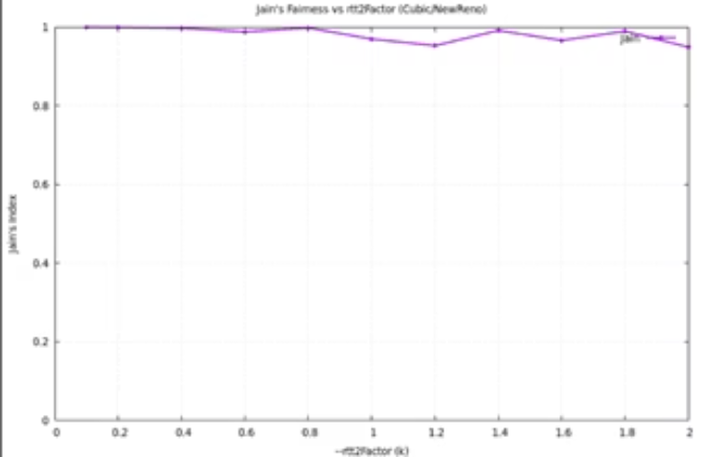
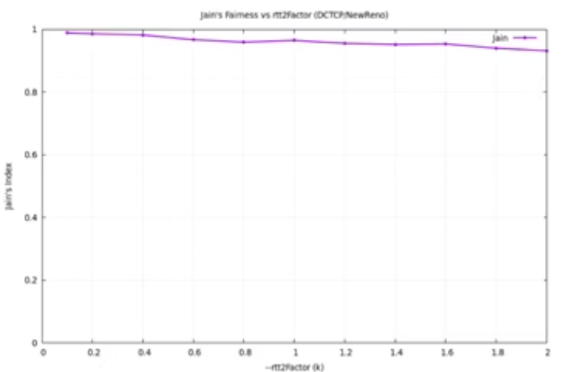
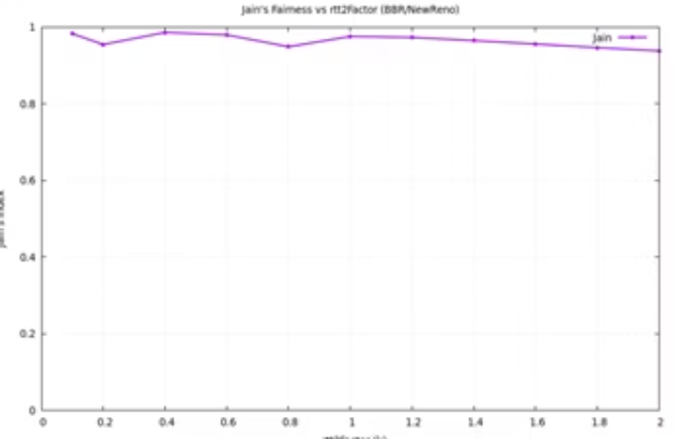
Results- different RTT
NewReno
NewReno-NewReno
Cubic-NewReno
Dctcp-NewReno
BBR-NewReno

Slide 19
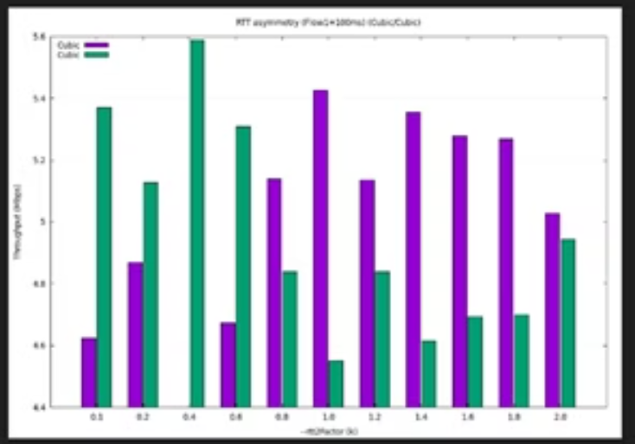
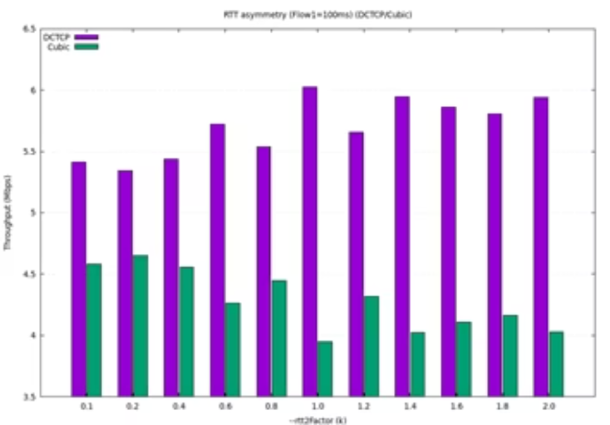
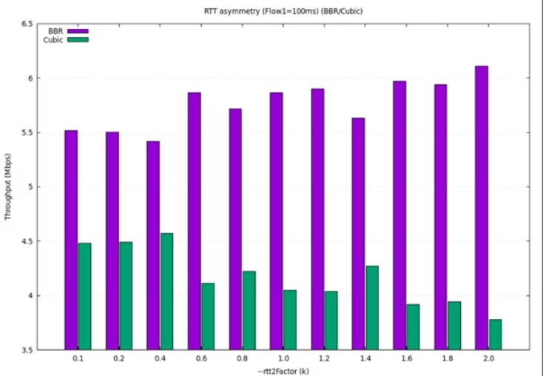
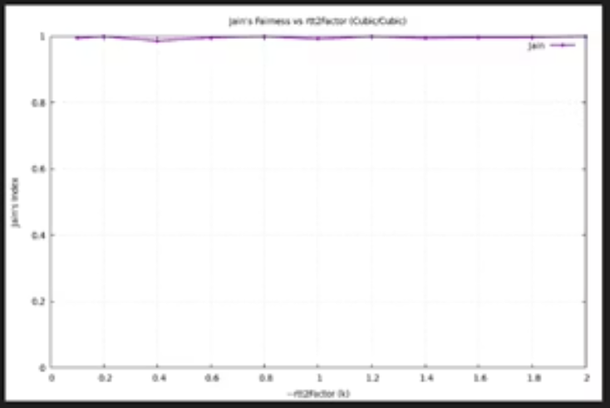
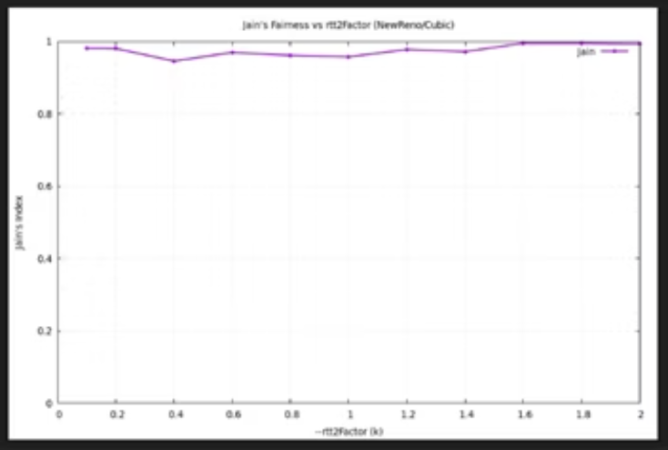
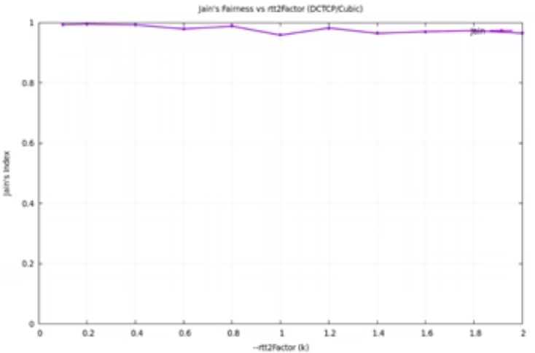
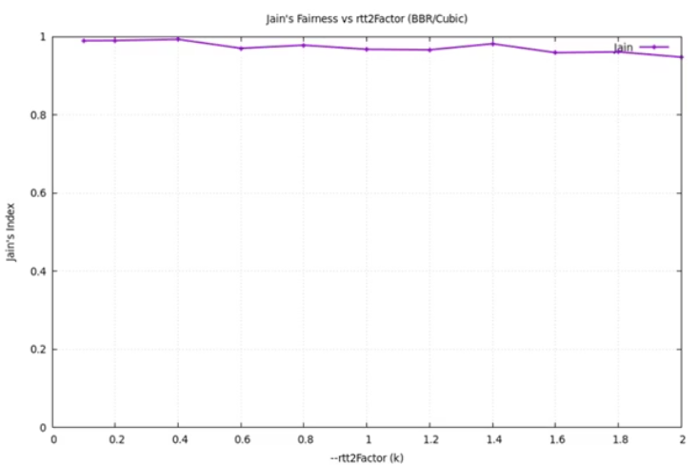
Results- different RTT
Cubic
Cubic-Cubic
NewReno-Cubic
Dctcp-Cubic
BBR-Cubic

Slide 20
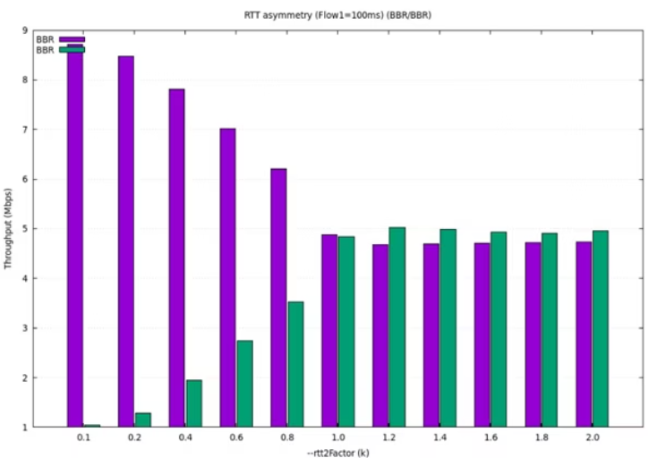
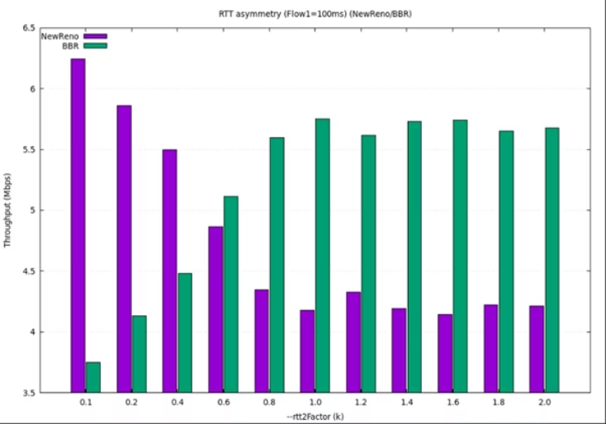
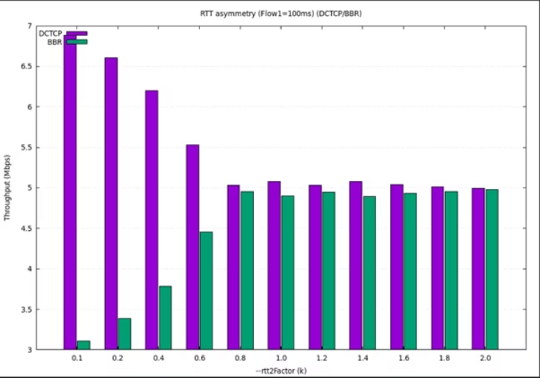
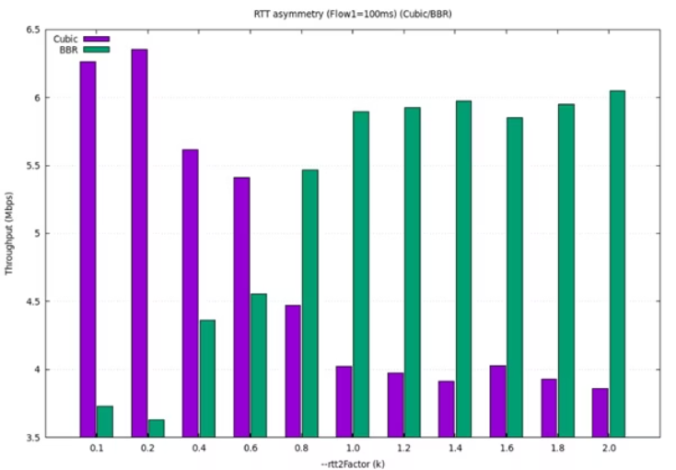




Results- different RTT
BBR
BBR-BBR
NewReno-BBR
Dctcp-BBR
Cubic-BBR

Slide 21








Results- different RTT
Dctcp
Dctcp-Dctcp
NewReno-Dctcp
Cubic-Dctcp
BBR-Dctcp

Slide 22
Conclusions
When Dctcp is paired with loss based CCA's - NewReno, Cubic- it captures the bandwidth
unrelated to RTT but due to its advanced algorithm dealing with congestion.
NewReno gets much less throughput when paired with other CCA's so it nearly losses bandwidth every time.
Cubic manages to get decent throughput when paired with other CCA's due to its fast growing cwnd.
when BBR has similar RTT to Dctcp and itself it’s protocol friendly. It manages to take appropriate throughput without outperforming the other protocol. But’ with NewReno and Cubic it causes outperformances.
The Max-Min Fairness principle holds when both protocols are the same and both flows have the same RTT.In other cases, it is difficult to determine, since both flows attempt to fully utilize the available bandwidth, but in practice they do not receive an equal share of it.
Modern protocols such as BBR and DCTCP are capable of sharing bandwidth efficiently and fairly, even under complex network conditions.

Slide 23
References & Appendix
GitHub Repository:
https://github.com/alaajalalabomokh/Fairness-among-TCP-connections.git
References :
What is TCP (Transmission Control Protocol)? - GeeksforGeeks
Wayback Machine
RFC 6582: The NewReno Modification to TCP's Fast Recovery Algorithm
DCTCP (DataCenter TCP) — The Linux Kernel documentation
TCP Fairness Among Modern TCP Congestion Control Algorithms Including TCP BBR | IEEE Conference Publication | IEEE Xplore

